Slide 1
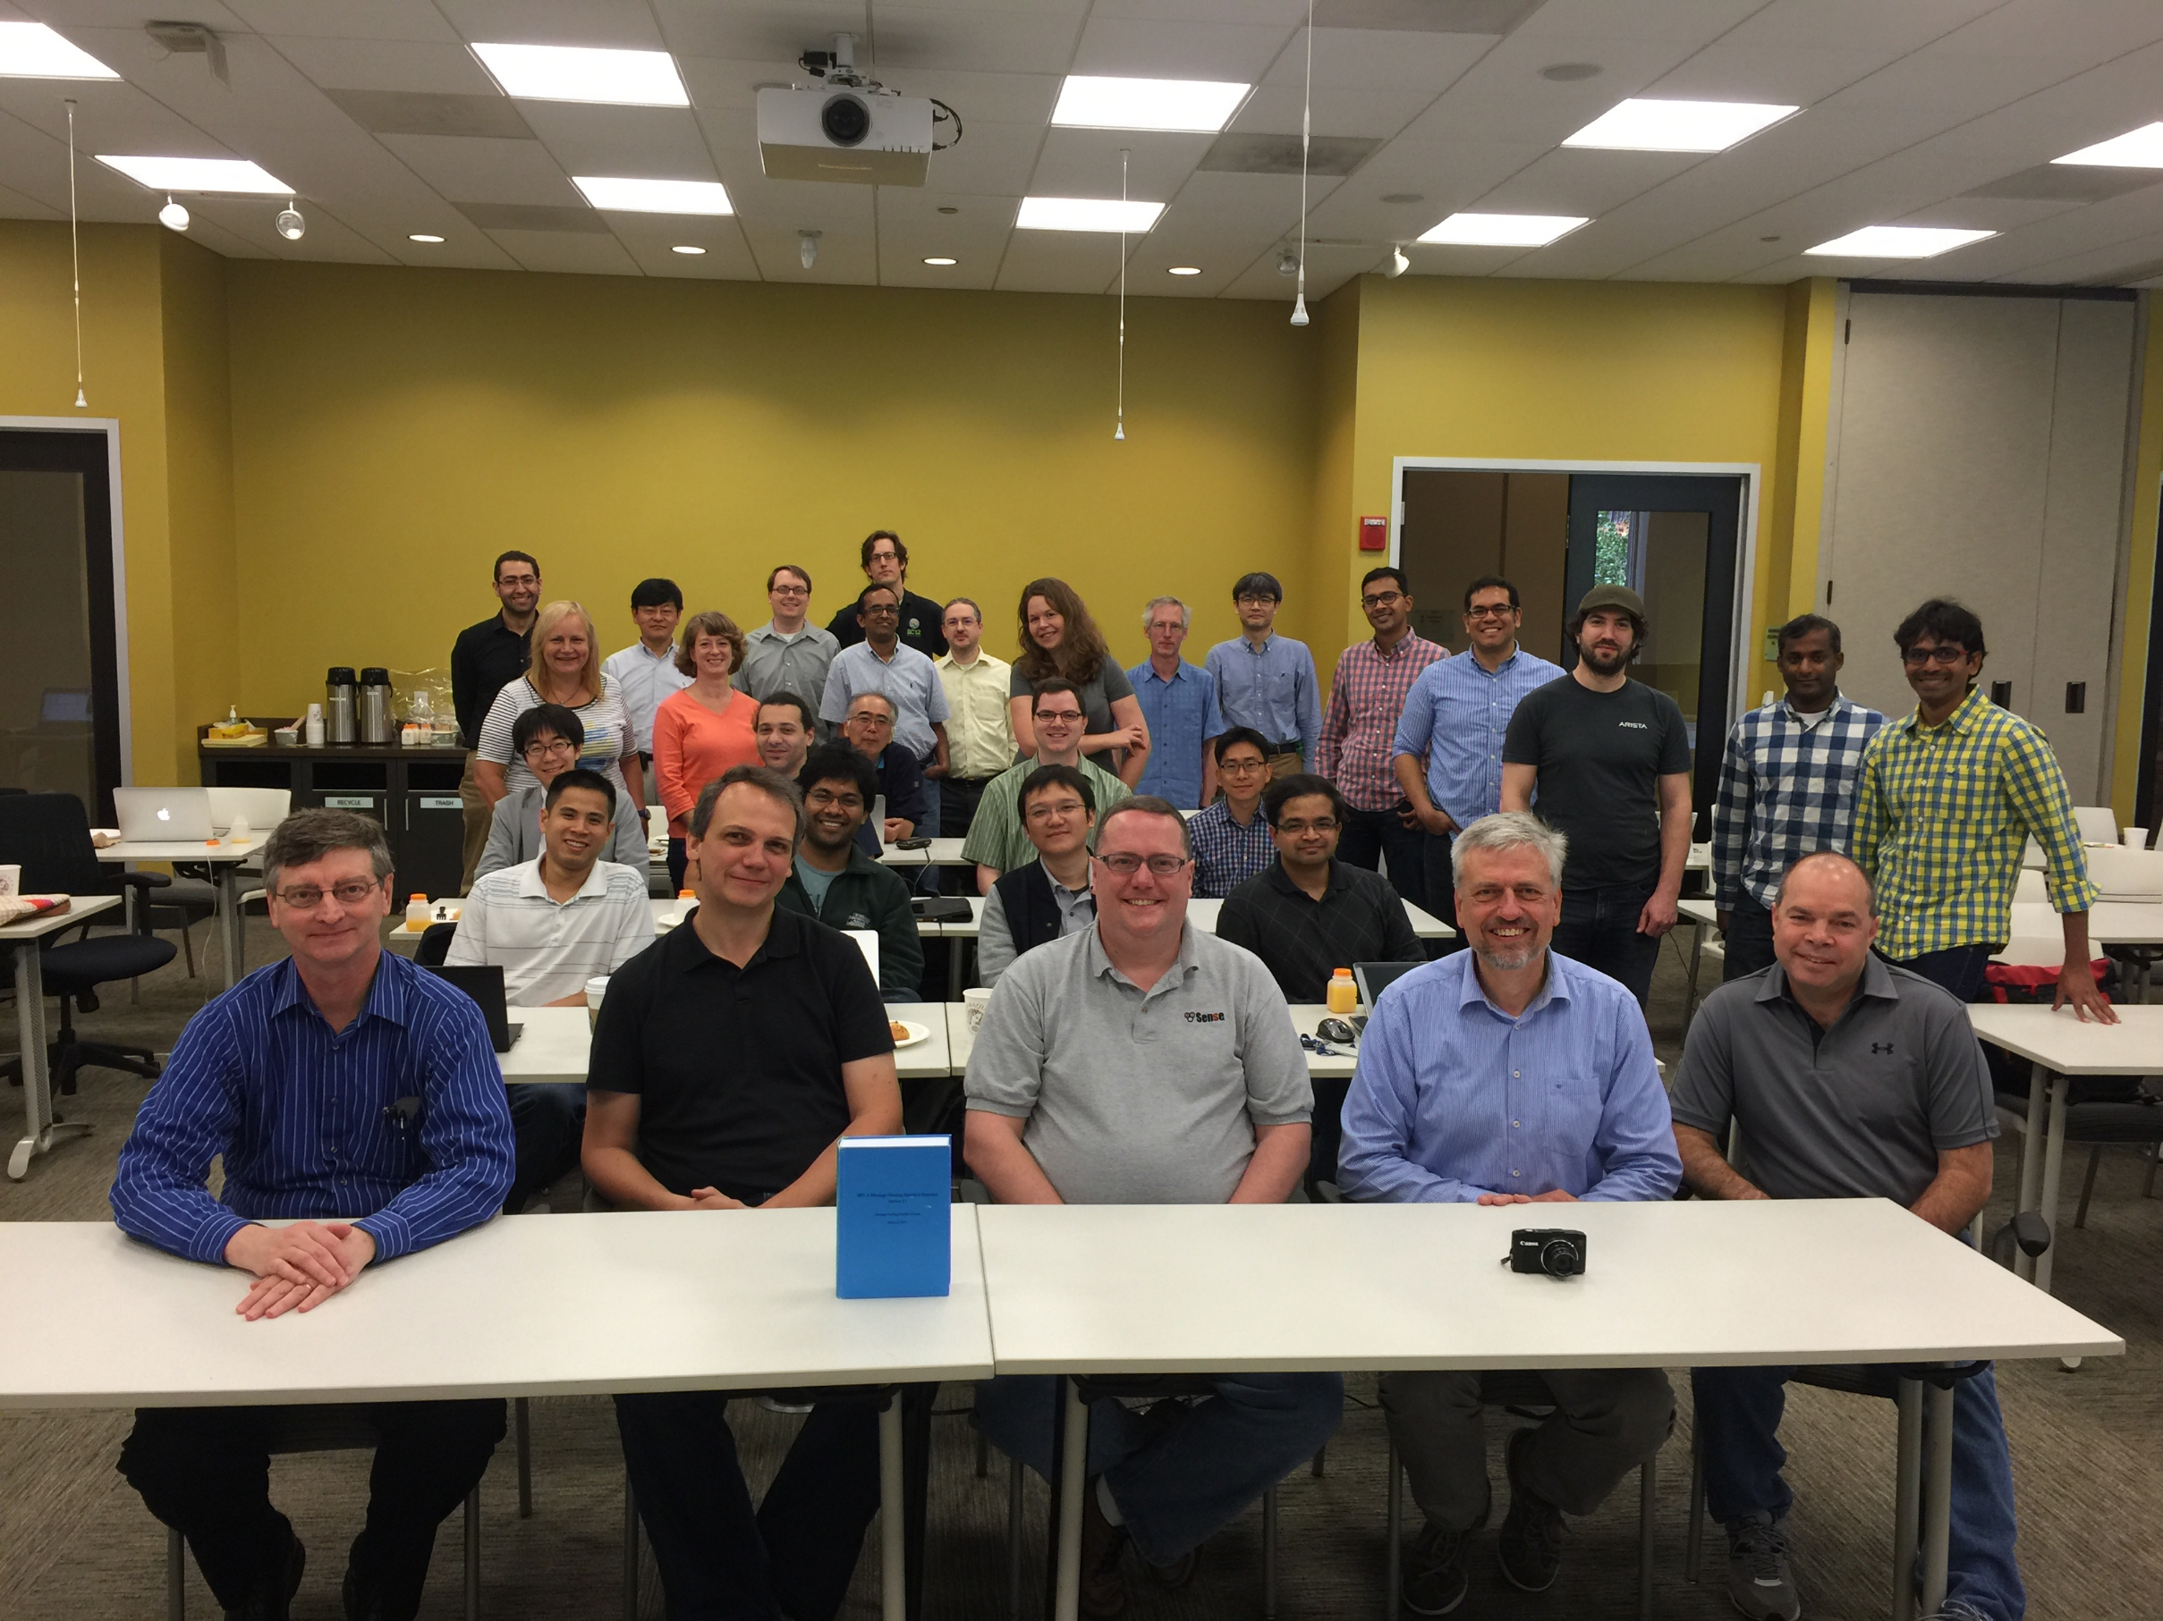
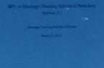
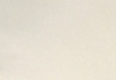
After final vote for MPI-3.1, June 4, 2015, at MPI Forum meeting in Chicago, June 1-4, 2015, Photo by David Eder with smart phone of Jeff Squyres
MPI-3.1_final-vote_MPI-Forum-2015.06.01-04-Chicago_Photographer-DaveEder.png
MPI: A Message-Passing Interface Standard
Version 3.1
Message Passing Interface Forum
June 4, 2015

Slide 2
MPI-3.1_final-vote_MPI-Forum-2015.06.01-04-Chicago_Photographer-DaveEder.png
MPI: A Message-Passing Interface Standard
Version 3.1
Message Passing Interface Forum
June 4, 2015
After final vote for MPI-3.1, June 4, 2015, at MPI Forum meeting in Chicago, June 1-4, 2015 Photo by David Eder with smart phone of Jeff Squyres

Slide 3
21
15
19
26
16
17
20
22
23
24
25
27
18
28
11
29
12
30
10
13
14
7
MPI-3.1_final-vote_MPI-Forum-2015.06.01-04-Chicago_Photographer-DaveEder.png
6
8
9
1
2
3
4
5
MPI: A Message-Passing Interface Standard
Version 3.1
Message Passing Interface Forum
June 4, 2015
After final vote for MPI-3.1, June 4, 2015, at MPI Forum meeting in Chicago, June 1-4, 2015 (Photo by David Eder with smart phone of Jeff Squyres)
1st row sitting: [1] William (Bill) Gropp (NCSA/UIUC), [2] Martin Schulz (LLNL, MPI-3.1 chair), [3] Jeff Squyres (Cisco), [4] Rolf Rabenseifner (HLRS), [5] Rich Graham (Mellanox)
2nd row sitting: [6] Anh Vo (Microsoft), [7] Pavan Balaji (ANL), [8] Xiaoyi Lu (OSU), [9] Krishna Kandalla (Cray),
3rd + 4th row sitting: [10] Takafumi Nose (Fujitsu), [11] Aurelien Bouteiller (U Tennessee), [12] Atsushi Hori (Riken), [13] Wesley Bland (Intel), [14] Sangmin Seo (ANL),
Standing: [15] Sameh Sharkawi (IBM), [16] Alice Koniges (LBNL), [17] Chulho Kim (Lenovo), [18] Kathryn Mohror (LLNL), [19] Ryan Grant (Sandia), [20] Puri Bangalore (UAB), [21] Jeff Hammond (Intel), [22] Daniel Holmes (EPCC), [23] Lena Oden (ANL), [24] Howard Pritchard (LANL), [25] Takeshi Nanri (Kyushu U) [26] Sayantan Sur (Intel), [27] Ignacio Laguna Peralta (LLNL), [28] Nathan Hjelm (LANL), [29] Manjunath Gorentla Venkata (ORNL), [30] Sreeram Potluri (Nvidia)
At the meeting, but not on the picture: Rajeev Thakur (ANL), Anthony Skjellum (Auburn U), Ken Raffenetti (ANL), Junchao Zhang (ANL) (Thanks to Jeff Squyres for assisting)

Slide 4
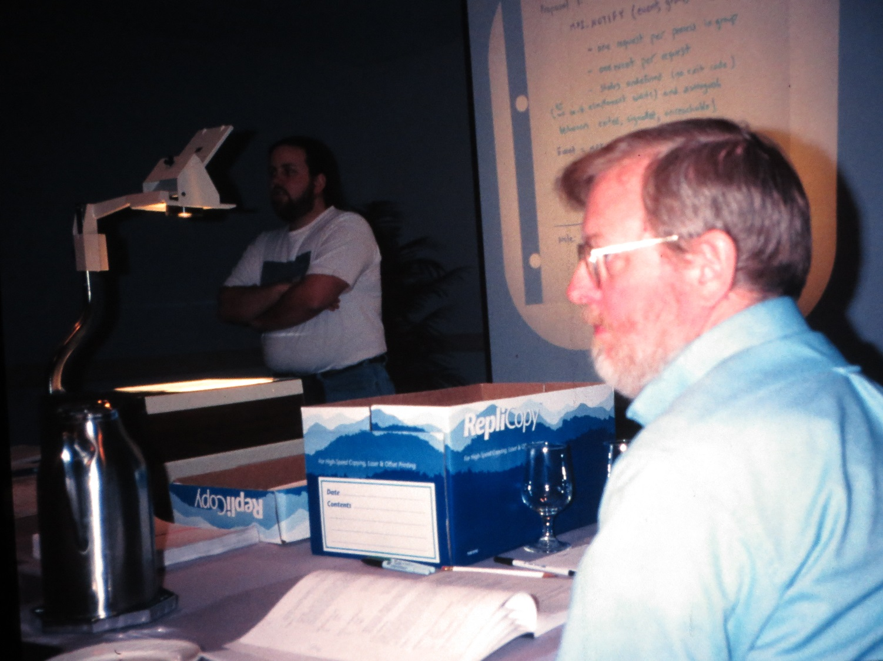
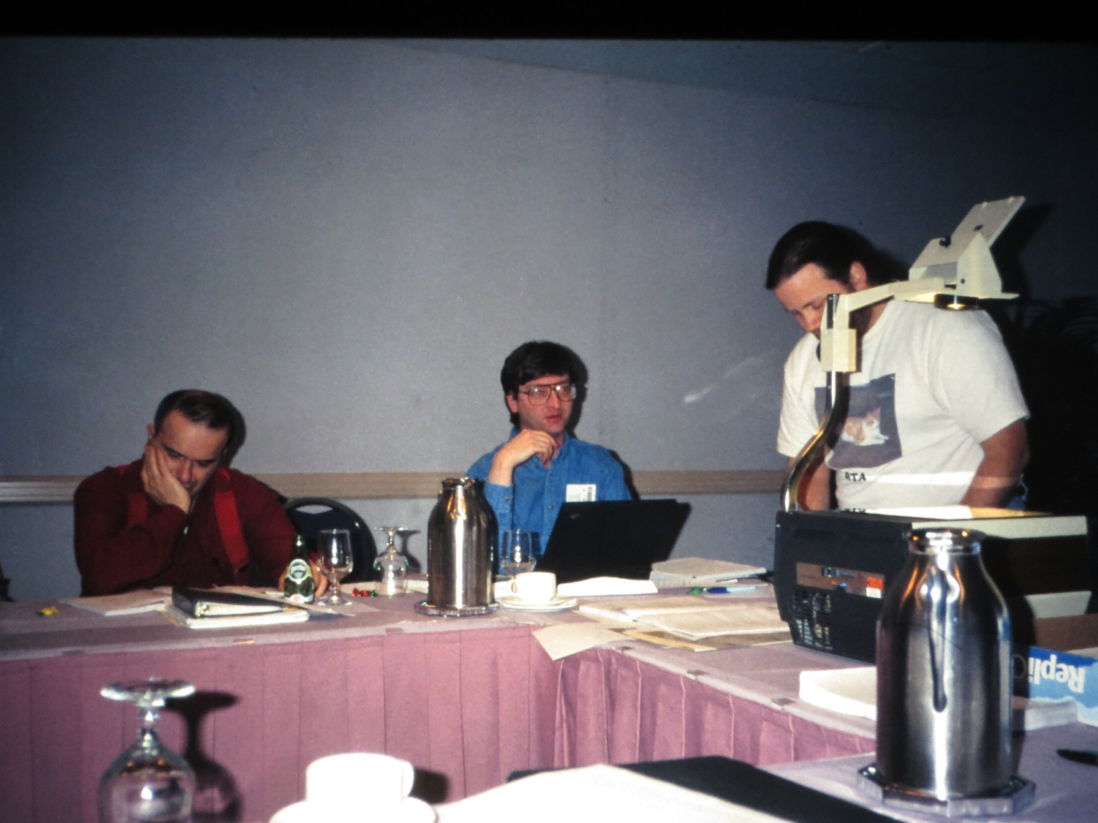
Bill Saphir (left) and Ewing (Rusty) Lusk (ANL, MPI1.2 & 2.0 convener and meeting chair)
IMG_0539_1996-1997_Chicago_MPI2.0-Forum_Chair-RustyLusk-in-fg.JPG
IMG_0540_1996-1997_Chicago_MPI2.0-Forum_MarcSnir+BillGropp+BillSaphir.JPG
(pictures from Rolf Rabenseifner)
MPI 1.2 and MPI-2.0 Forum 1995 - 1997
Marc Snir, Bill Gropp, Bill Saphir (from left)
Pictures from Rolf Rabenseifner

Slide 5
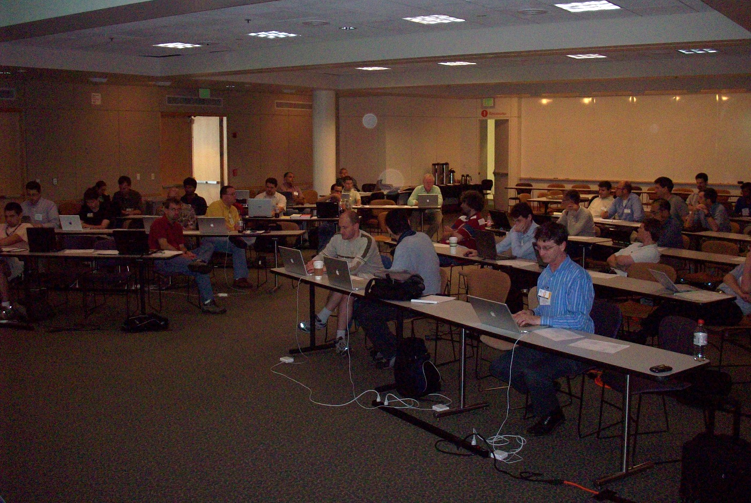
100_1913_2008.06.30-07.02_MPI21-meeting-SanFrancisco.jpg
(picture from Rolf Rabenseifner)
MPI-2.1 Forum Meeting June 30 – July 2, 2008, Menlo Park, CA, USA First vote for MPI-1.3 and MPI-2.1

Slide 6
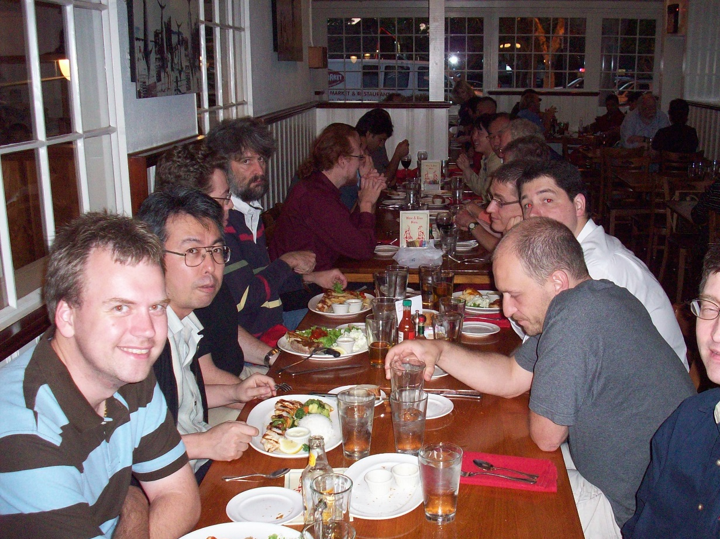
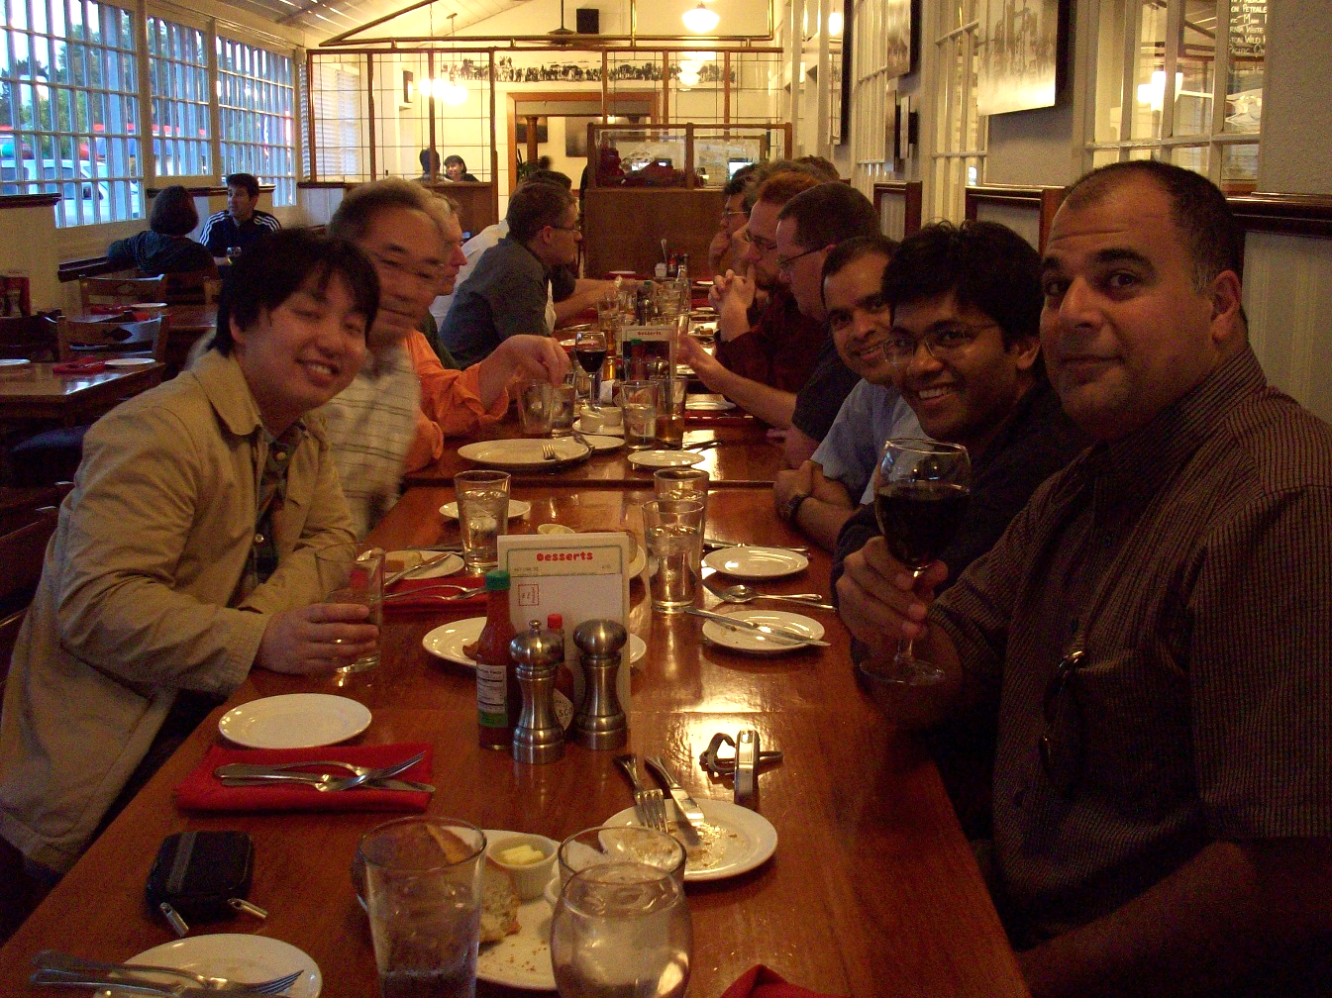
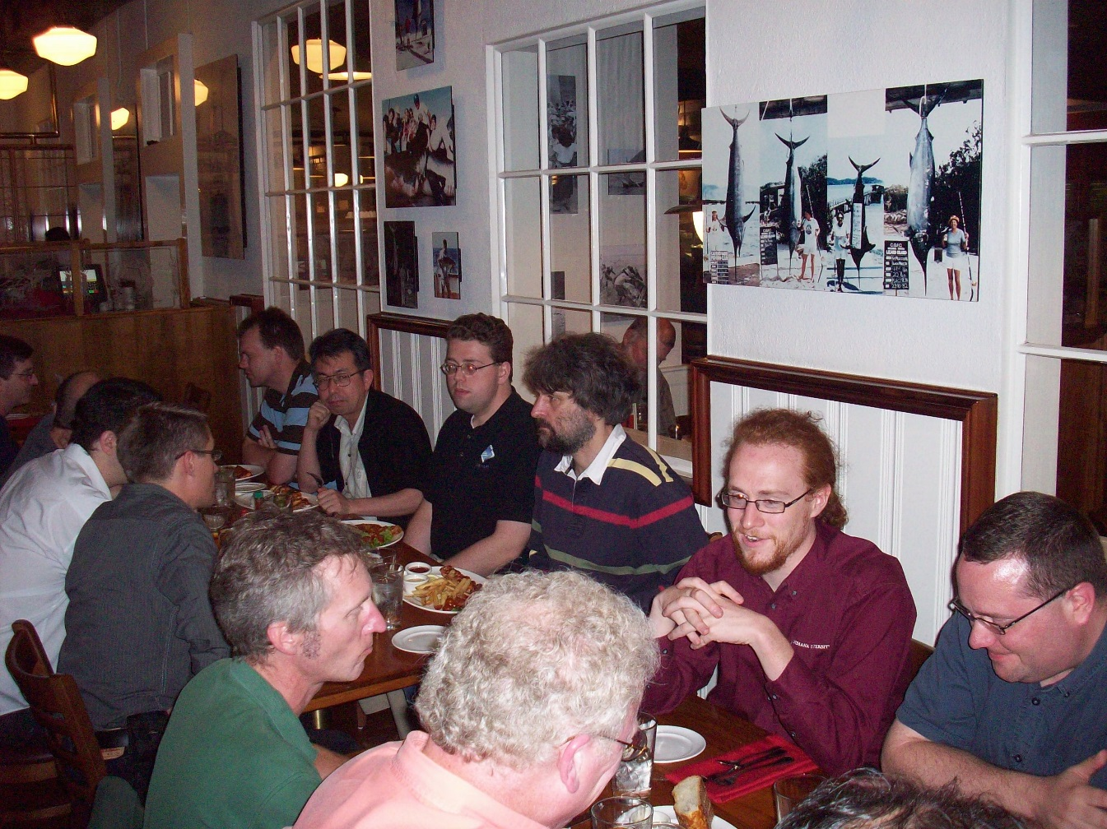
MPI-2.1 Forum Meeting June 30 – July 2, 2008, Menlo Park, CA, USA Forum Dinner
100_1920_2008.06.30-07.02_MPI21-meeting-SanFrancisco.jpg (left top)
100_1921_2008.06.30-07.02_MPI21-meeting-SanFrancisco.jpg (left bottom)
100_1919_2008.06.30-07.02_MPI21-meeting-SanFrancisco.jpg (right side)
(picture from Rolf Rabenseifner)

Slide 7
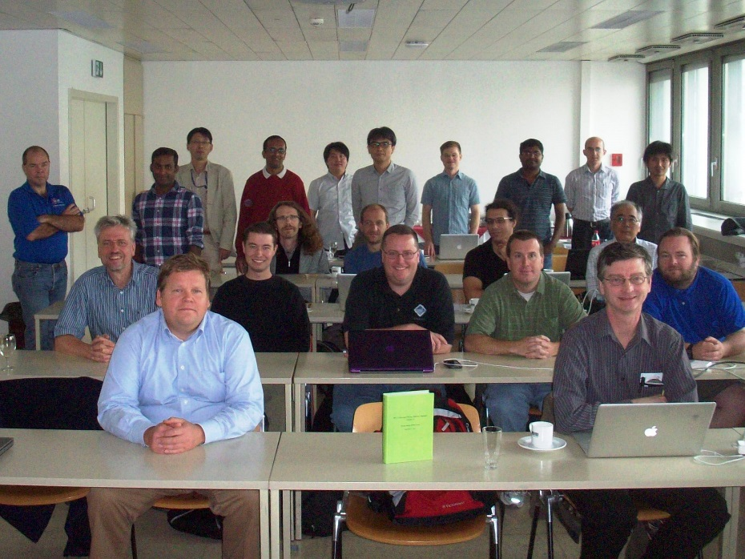
102_2051a_2012.09.23-26_Vienna_MPI30-final-vote_wo-Jesper.JPG
102_2049a_2012.09.23-26_Vienna_MPI30-final-vote_wo-Rolf.JPG
102_2051a+2049a_2012.09.23-26_Vienna_MPI30-final-vote_combinded-by-JuttaSauer.jpg
(pictures from Rolf Rabenseifner)
After final vote for MPI-3.0, Sep. 21, 2012, at MPI Forum meeting in Vienna, Austria, Sep. 20-21, 2012 Photos by Jesper Traeff and Rolf Rabenseifner

Slide 8
14
17
20
15
16
18
19
12
21
13
102_2051a_2012.09.23-26_Vienna_MPI30-final-vote_wo-Jesper.JPG
102_2049a_2012.09.23-26_Vienna_MPI30-final-vote_wo-Rolf.JPG
102_2051a+2049a_2012.09.23-26_Vienna_MPI30-final-vote_combinded-by-JuttaSauer.jpg
(pictures from Rolf Rabenseifner)
11
8
9
10
3
4
5
7
6
1
2
After final vote for MPI-3.0, Sep. 21, 2012, at MPI Forum meeting in Vienna, Austria, Sep. 20-21, 2012
1st row sitting (from left to right:): [1] Alexander Supalov (Intel), [2] William (Bill) Gropp (NCSA/UIUC),
2nd row sitting: [3] Rolf Rabenseifner (HLRS), [4] David Goodell (ANL), [5] Jeff Squyres (Cisco), [6] Brian Barrett (Sandia), [7] ] Brian Smith (ORNL),
3rd + 4th row sitting: [9] Jesper Traeff (TU Vienna), [8] George Bosilca (INRIA), [10] Aurelien Bouteiller (U. Tennessee), [11] Atsushi Hori (Riken AICS),
Standing: [12] Rich Graham (Mellanox, MPI-3.0 chair), [13] Manjunath Gorentla Venkata (ORNL), [14] Shinji Sumumoto (Fujitsu), [15] Puri Bangalore (UAB), [16] Hideyuki Jitsumoto (U.Tokyo), [17] Takeshi Nanri (Kyushu U.), [18] Christian Siebert (GRS-Sim), [19] Devendar Bureddy(OSU), [20] Paddy Gillies (AWE Plc), [21] Tomotake Nakamura (Riken AICS)
Probably not on the picture, but at the meeting: Nathan Heljm (LANL) (Thanks to Atsushi Hori for assisting)
(Photos by Jesper Traeff and Rolf Rabenseifner) (Combined by Jutta Sauer)

